Slide 1
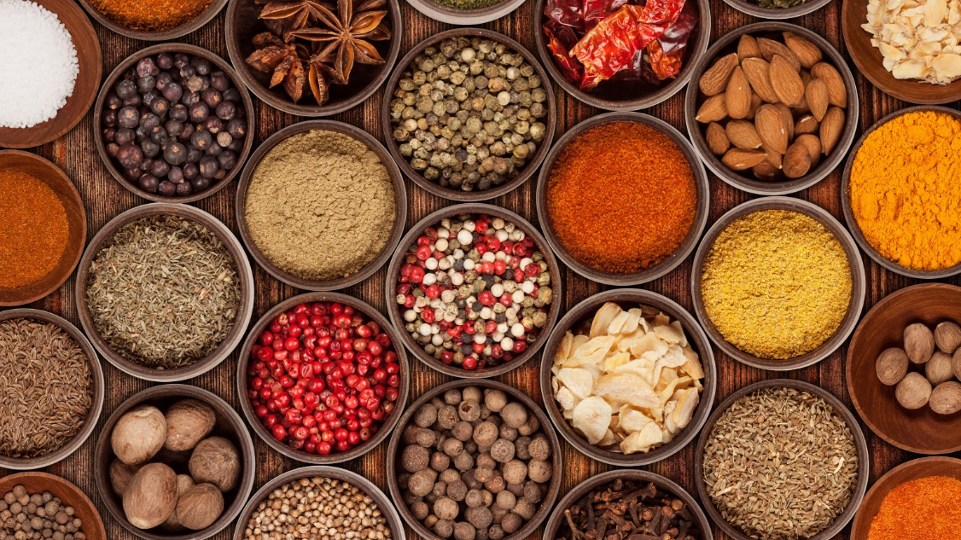
Right to food, Access to cultural foods and Sense of belonging
Dr Christine Stevens
University of Washington Tacoma

Slide 2

The right to food is a human right recognized by international human rights law.
“The Universal Declaration of Human Rights recognizes:
“Everyone has the right to a standard of living adequate for the health and well-being of himself and of his family, including food,...”

Slide 3
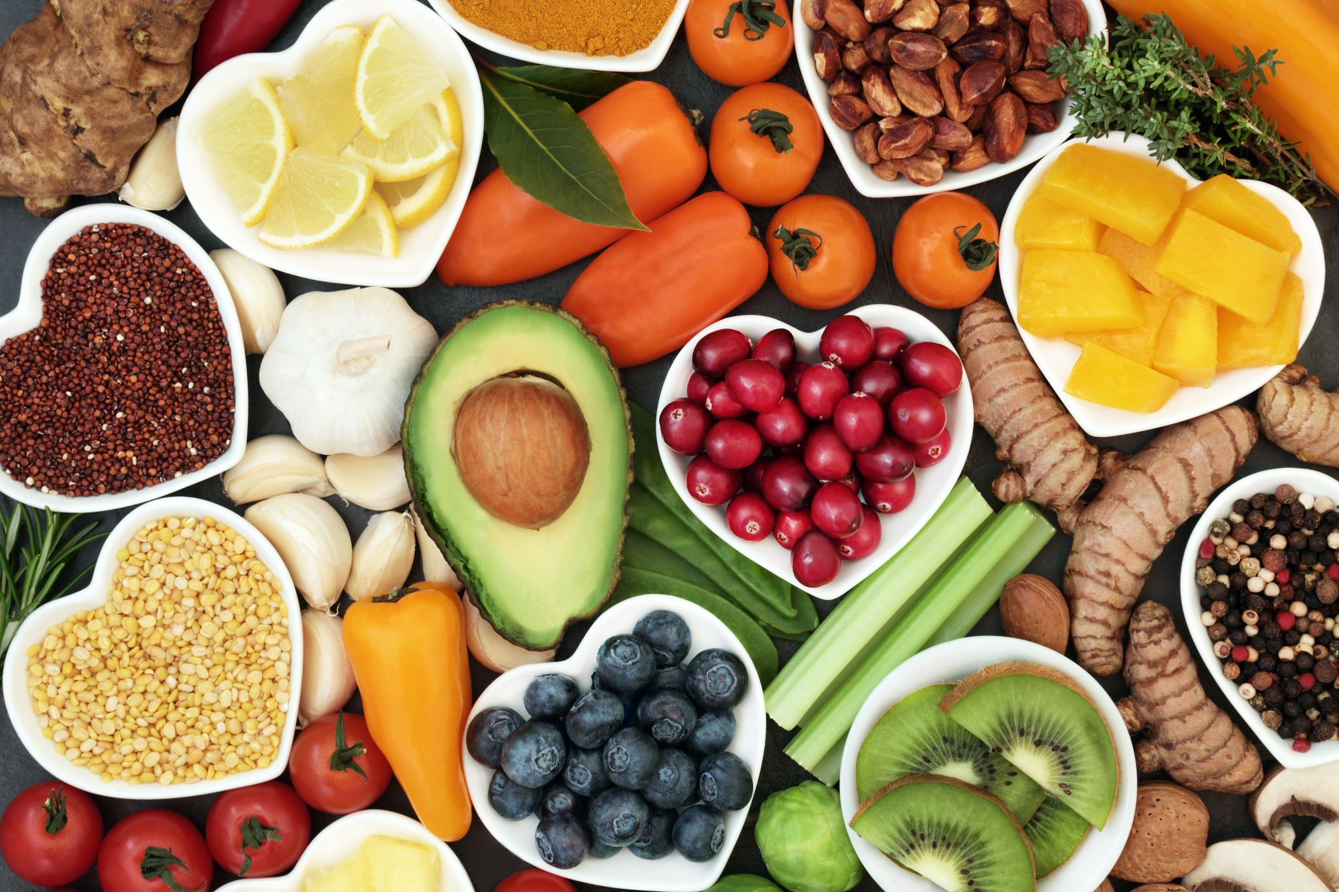
United Nations Declaration of Human Rights Right to Food
Available
available from natural resources
food should be available for sale in markets and shops
cultural traditions of the people
Accessible
Economic accessibility means that food must be affordable.
Without compromising other basic needs
Physical access
Access to land to grow food
Adequate
Satisfy dietary needs,
energy-dense and low-nutrient
culturally acceptable

Slide 4

What about Justice and
Human rights locally?
Food sovereignty is nourishment provided by traditional foods and gathered locally and honored and shared in traditional ways.
In 1854 Treaty of Medicine Creek, Puyallup people were forced to give up rights to land and access to Indigenous food
The tribal members had to fight for their fishing rights in 1974
History of Puyallup
Notes:
1974
Judge Bo1dt decision upholds treaty fishing rights Squaxin
The tribe has the federally upheld treaty right to harvest 50 percent of naturally occurring shellfish on privately owned tidelands. If the owner desires, the tribe will harvest the owner’s half and split the profits.

Slide 5
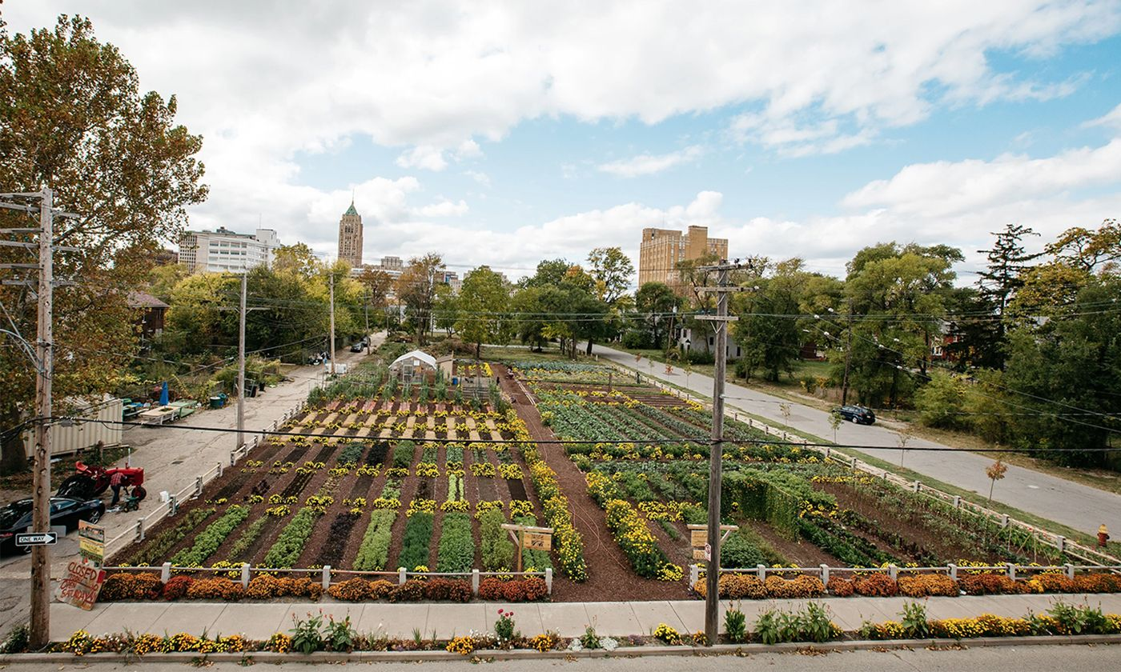
Detroit USA
What about human rights of food in US?
Food Apartheid: beyond food deserts
https://www.youtube.com/watch?v=IUeFtaujl7E
Notes:
Nyema Clark

Slide 6
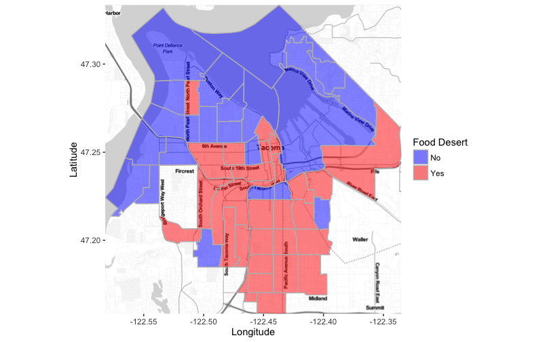
Food Apartheid: beyond food deserts https://www.youtube.com/watch?v=IUeFtaujl7E
UWT

Slide 7
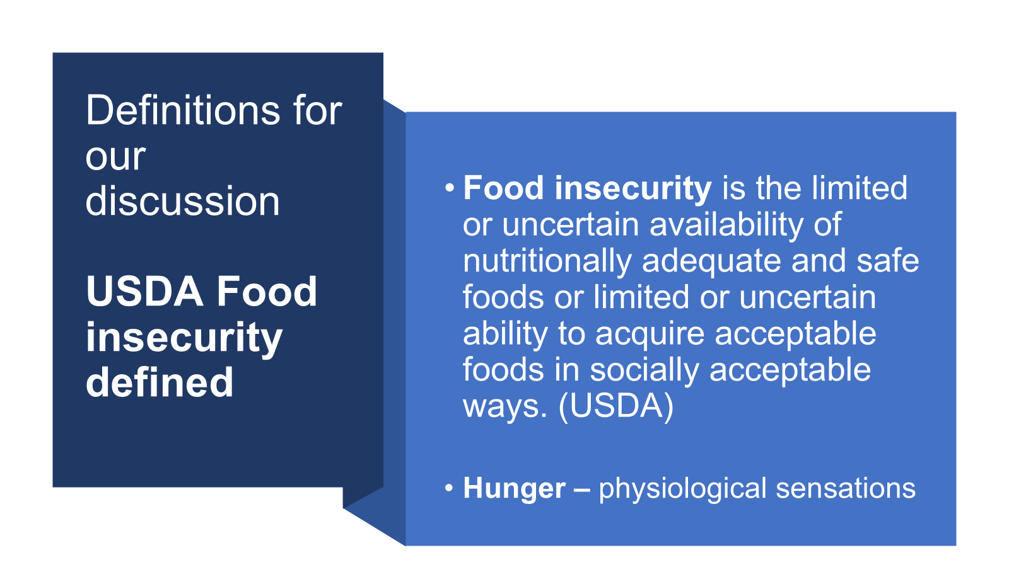
Definitions for our discussion
USDA Food insecurity defined
Food insecurity is the limited or uncertain availability of nutritionally adequate and safe foods or limited or uncertain ability to acquire acceptable foods in socially acceptable ways. (USDA)
Hunger – physiological sensations

Slide 8
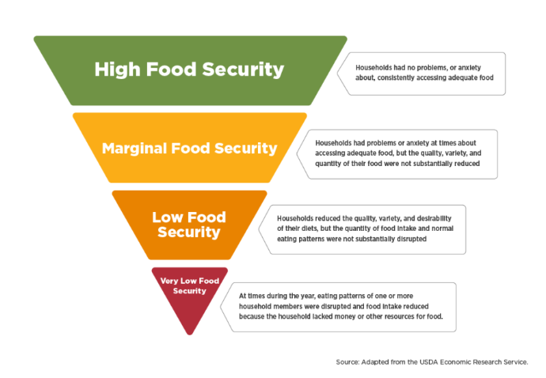

Slide 9
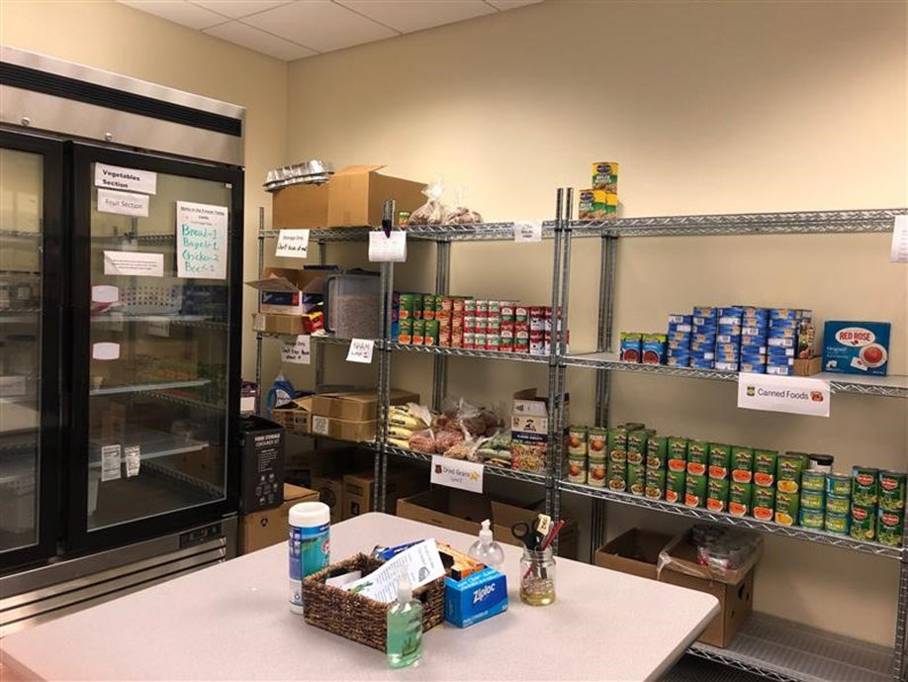
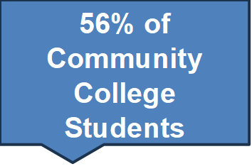
Students who have
low to very low food security
48%
of
UW Tacoma Students
May 2024
48% UWT students are food insecure even working full time
36 - 42 %
of
US University Students

Slide 10
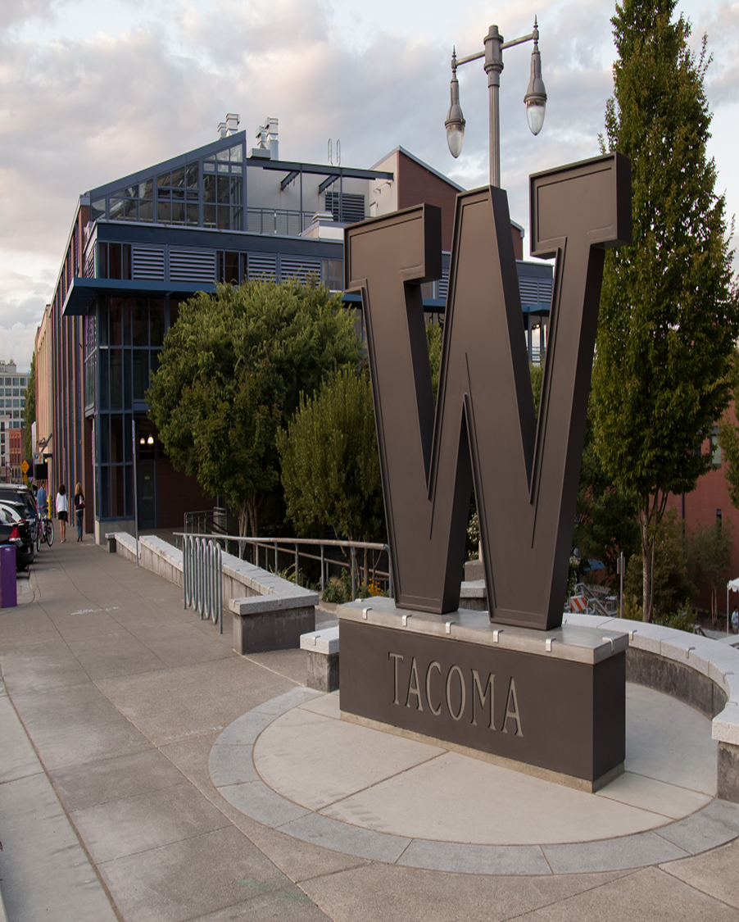
HISTORY OF THE UW TACOMA PANTRY
Administration at the time did not feel we had the need for a pantry.
“if they cannot afford food, then maybe they should not come”
The Center for Equity and Inclusion started Pantry
Shifting the language from charity to food justice

Slide 12
UWT compared to US population

Slide 13
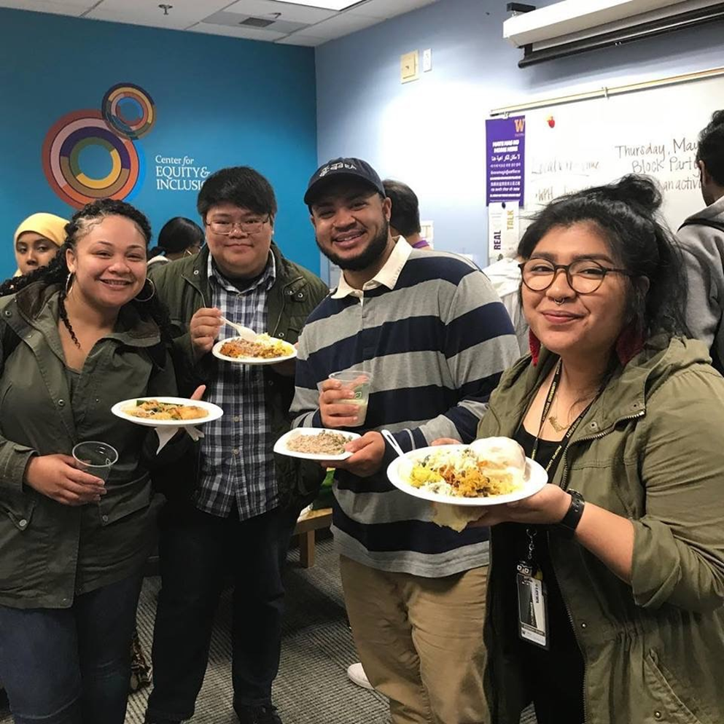
RESPONSES FROM
UWT CULTURAL FOOD RESEARCH
One participant echoed many times during the focus group: “I cannot believe that you are even asking this question…this question about foods that remind me of home…makes me feel seen.”
“Spices are expensive and I cannot afford them but if I had spices so I could have the taste and smell of home…it would change how I would feel about the food.”

Slide 14
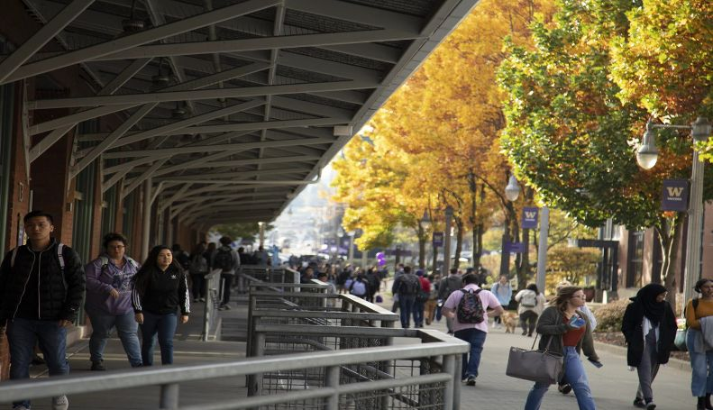
CREATING A SENSE OF BELONGING
What does belonging look like at UW Seattle and UW Tacoma?
    Feeling welcomed and respected in the classroom
    Finding community through shared experiences
    all identities are welcomed
    Feeling supported academically, culturally, emotionally and basic needs are being met
Our message
You don’t have to leave your culture at the doors of the institution.
Your food, your language, your traditions, your identities—all belong here.

Slide 15
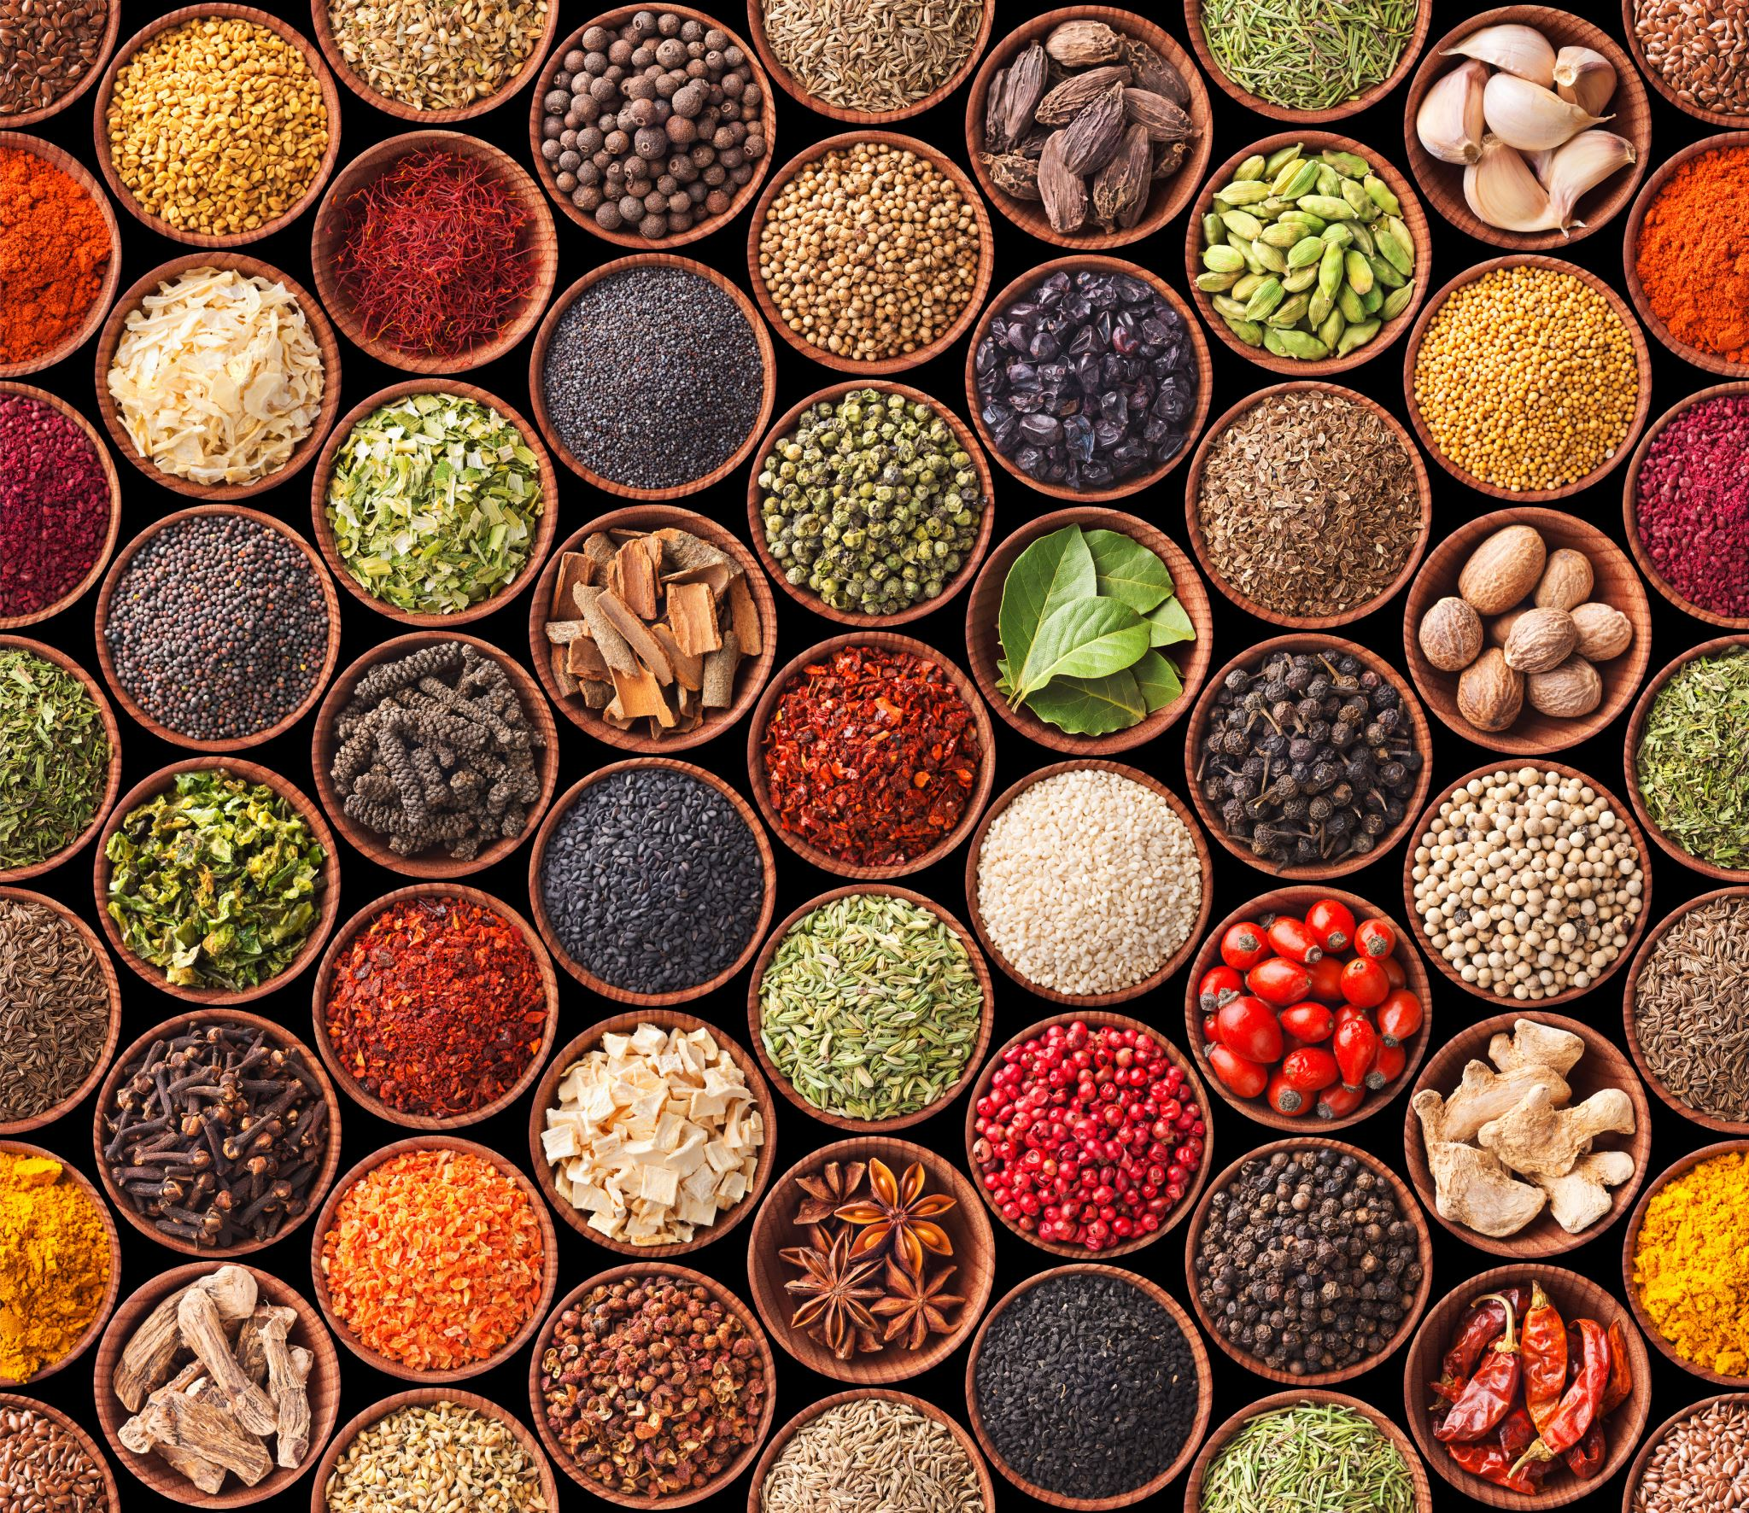
Cultural foods in college and community food banks
Honoring Identity, Nourishing Community
Spices that carry stories
The flavors of home that connect people to family, memory, and tradition.
Beans, noodles, grains, and staples
Everyday foods that affirm cultural identity and dignity.
Halal, kosher, and culturally specific items
Food that respects diverse beliefs and practices, ensuring everyone feels seen.
Why it matters:
Providing culturally meaningful foods isn’t charity—

Slide 17
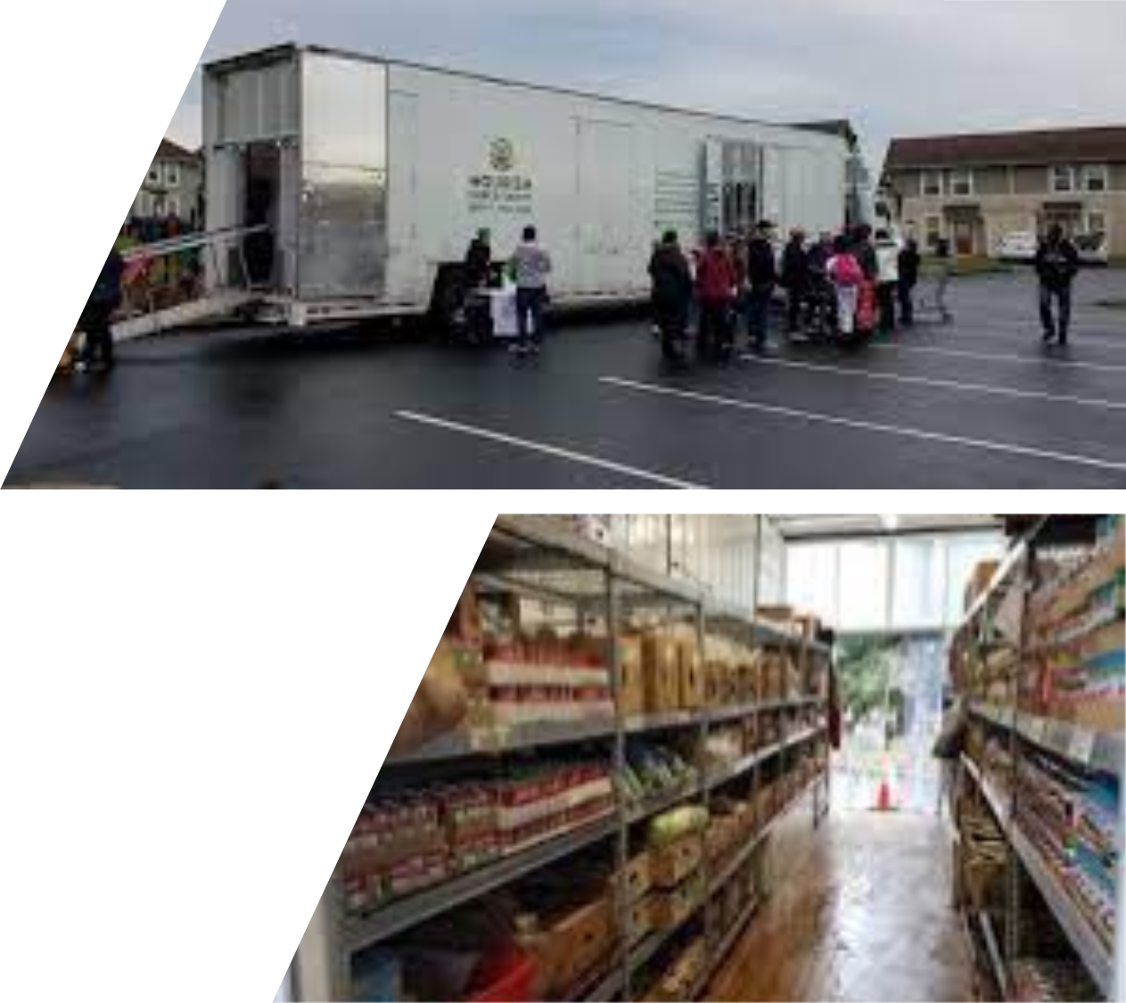
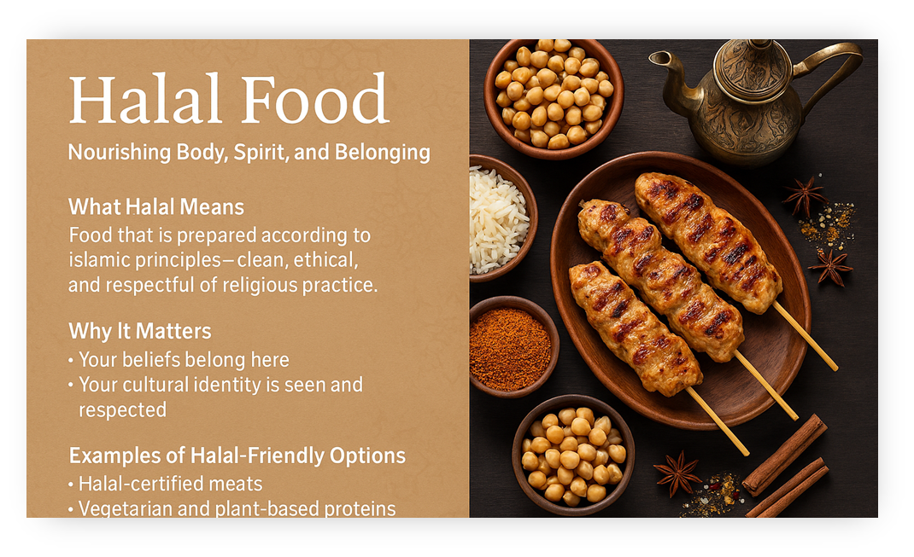
Community Partnerships
Nourish Pierce County

Slide 18
